Slide 1
Exploring the Effect of Data Augmentation on the Quality of Text Classification
Shabnam Sadegharmaki, May 2019

Slide 2
Outline
Problem Statement
  Text Classification
  Expensive training data
  Domain specific
Use cases
  News classification project at Allianz
  Legal Norm classification at Sebis chair
  Hateful speech classification of tweets
Solutions
  Semi Supervised Learning
    Self-training
    Graph based SSL
  Text Data Augmentation
    Horizontal
    Vertical
    Hypernyms
Conclusion
References

Slide 3












Text Classification
Training
Classification
$$L :labeled data$$
$$L_{Training}$$
$$U_{unseen}=$$
$$U_{unlabeled}$$
$$L_{Test}$$
$$L_{Training}$$
Classifier
$$U_{unseen}$$
$$L_{Test}$$
Classifier
ML

Slide 4
Curse of Supervised Methods
Labeled Data:
  The More, The Better
However:
  Expensive and Scarce
On the other hand,
  Vast amount of unlabeled data
Labeled
Unlabeled

Slide 5
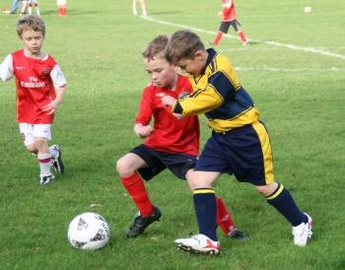
Counter attacks
Semi-supervised learning
  Self-training
  Label propagation
Thesaurus-based data augmentation
Multi-instance learning
Transfer Learning
© clipart-library
The focus is limited to text classification
Notes:
Semi-supervised techniques affect the algorithm directly by
enabling it to consume the unlabeled data as well as labeled ones.
Data augmentation, on the other hand, transforms and expands the
data even before feeding to the algorithm. Multi-instance learning
enables to utilize the labels for a bag of instances instead of each
one separately. Transfer learning can apply the knowledge in another
domain with enough samples to process the domain with less
training data.

Slide 6
But …
The solutions do not work in all domains
Therefore …
We chose three diverse datasets
1. to investigate their effects on different domains
2. to estimate their generalization power

Slide 7
Outline
Problem Statement
  Text Classification
  Expensive training data
  Domain specific
Use cases
  News classification project at Allianz
  Legal Norm classification at Sebis chair
  Hateful speech classification of tweets
Solutions
  Semi Supervised Learning
    Self-training
    Graph based SSL
  Text Data Augmentation
    Horizontal
    Vertical
    Hypernyms
Conclusion
References

Slide 8
Dataset 1: Legal Norms(LN)
601 Sentences from the German BGB with regard to the tenancy law
Manually labeled to 9 semantics:
Legal domain
Technical
Grammatically correct
No typo
Formal speech
Small domain
Semantic type | Occurrences | Rel occurr. (%)
Duty | 117 | 19
Indemnity | 8 | 1
Permission | 148 | 25
Prohibition | 18 | 3
Objection | 98 | 16
Continuation | 21 | 3
Consequence | 117 | 19
Definition | 18 | 3
Reference | 56 | 9
Properties:

Slide 9
Dataset 2: GermEval18, hate speech tweets
A publicly available dataset of 5009 tweets in German
Binary classification of
whether a tweet contains offensive content
Social network domain
Informal speech
Error and typo prone
Short texts
Emoji
Short content
Properties:
Labels | Occurrences | Rel occurr. (%)
Offensive | 1688 | 34%
Other | 3321 | 66%

Slide 10
Dataset 3: Economic News Allianz
This is a private dataset provided by one of Allianz entities
Contains 2278 News regarding Germany economy and industry
Binary classification of whether a news is critical for Allianz business
Economy Domain
Formal speech
Long text
Grammatically correct
No typo
Properties:
Semantic type | Occurrences | Rel occurr. (%)
Critical | 282 | 12
Non-critical | 1996 | 88

Slide 11
Outline
Problem Statement
  Text Classification
  Expensive training data
  Domain specific
Use cases
  News classification project at Allianz
  Legal Norm classification at Sebis chair
  Hateful speech classification of tweets
Solutions
  Semi Supervised Learning
    Self-training
    Graph based SSL
  Text Data Augmentation
    Horizontal
    Vertical
    Hypernyms
Conclusion
References

Slide 12
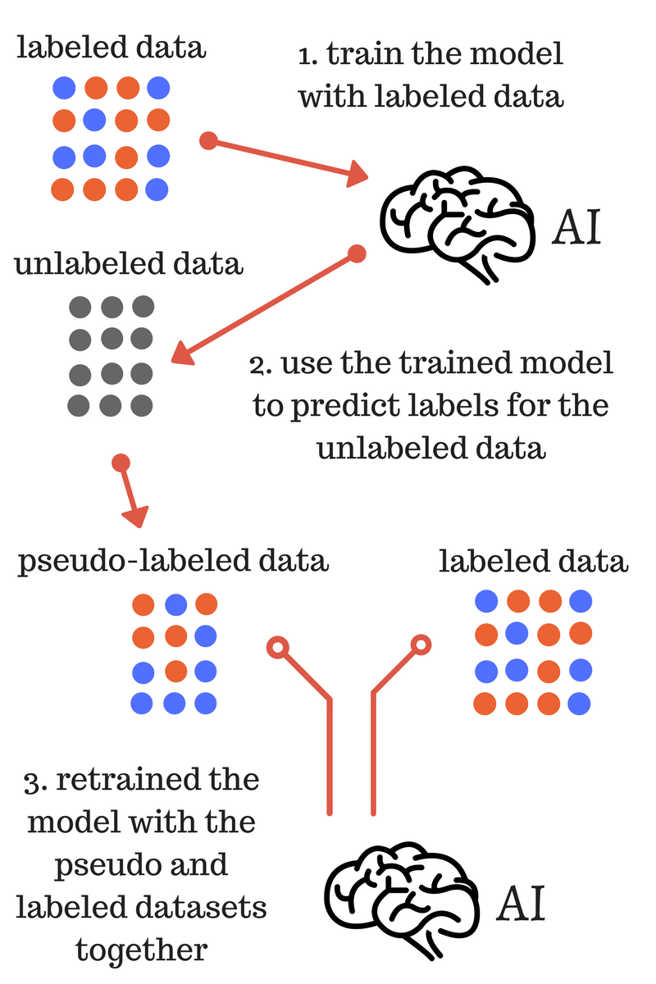
SSL: Self-training

Slide 13
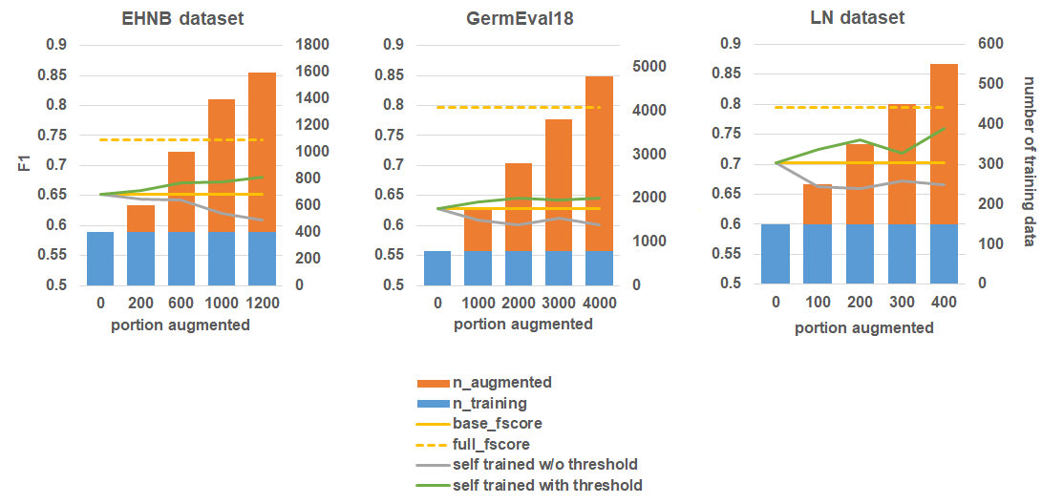
Self-training: Results

Slide 14
Outline
Problem Statement
  Text Classification
  Expensive training data
  Domain specific
Use cases
  News classification project at Allianz
  Legal Norm classification at Sebis chair
  Hateful speech classification of tweets
Solutions
  Semi Supervised Learning
    Self-training
    Graph based SSL
  Text Data Augmentation
    Horizontal
    Vertical
    Hypernyms
Conclusion
References

Slide 15


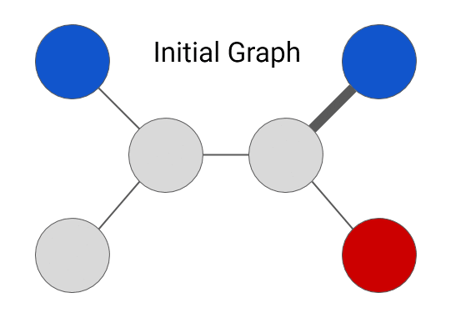
SSL: Label Propagation
Graph:
Nodes are both labeled and unlabeled
Edges reflect the similarity of examples.
Classification: Label Propagation
Parameter to be tuned:
        Alpha
        Gamma
© ai.googleblog

Slide 16
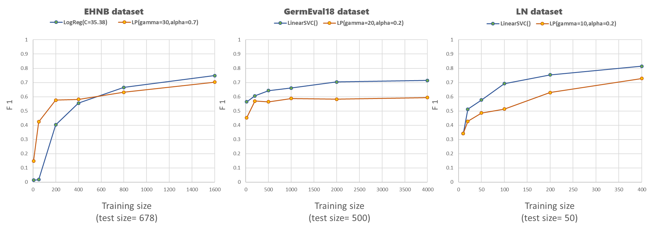
Label Propagation: Results

Slide 17
Outline
Problem Statement
  Text Classification
  Expensive training data
  Domain specific
Use cases
  News classification project at Allianz
  Legal Norm classification at Sebis chair
  Hateful speech classification of tweets
Solutions
  Semi Supervised Learning
    Self-training
    Graph based SSL
  Text Data Augmentation
    Horizontal
    Vertical
    Hypernyms
Conclusion
References

Slide 18
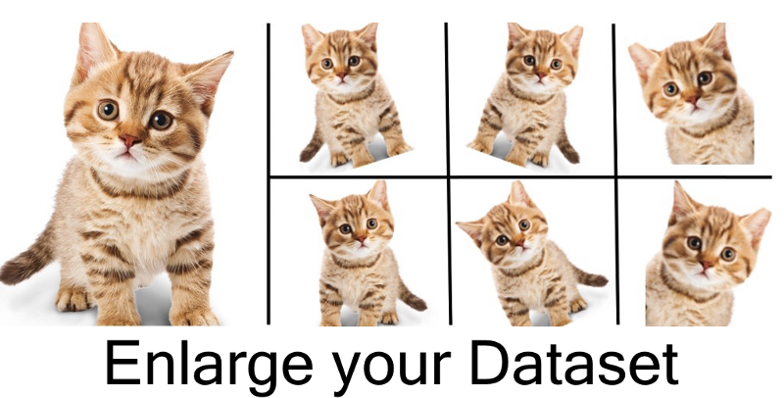
Data Augmentation
© medium.com/nanonets

Slide 19
Data augmentation in Text
Trivial Solution is paraphrasing
Original: Her life spanned years of incredible change for women as they gained more rights than ever before.
Paraphrase: She lived through the exciting era of women's liberation.
However:
Even harder than labeling for human expert
Meaning is very subjective
Solution:
Thesaurus-based augmentation

Slide 20
Thesaurus-based data augmentation
Thesaurus of Synonyms, Hypernyms, Hyponyms
GermaNet → German
WordNet → Other languages
Mietvertrag
Synonyms:
Pacht, Pachtvertrag, Mietvereinbarung
Hypernyms:
Vertrag
Hyponyms:
Charter

Slide 21
Idea behind it …
The weather is nice
+
The weather is awful
-
The weather is decent
?

Slide 22

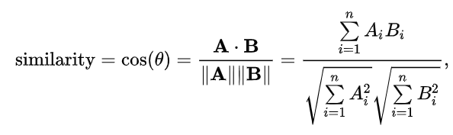
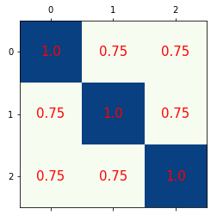
Idea behind it …
The weather is nice
+
The weather is awful
-
The weather is decent
?

Slide 23
Data Augmentation
This is not only about increasing training size
But also expanding the semantics
Alternations:
Horizontal augmentation by synonyms
Vertical augmentation by synonyms
Augmentation by hypernyms

Slide 24
Outline
Problem Statement
  Text Classification
  Expensive training data
  Domain specific
Use cases
  News classification project at Allianz
  Legal Norm classification at Sebis chair
  Hateful speech classification of tweets
Solutions
  Semi Supervised Learning
    Self-training
    Graph based SSL
  Text Data Augmentation
    Horizontal
    Vertical
    Hypernyms
Conclusion
References

Slide 25


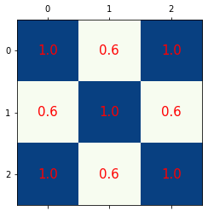
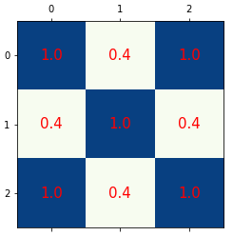
Horizontal augmentation by synonyms
The weather is nice decent
+
The weather is awful bad
-
The weather is decent nice
?

Slide 26
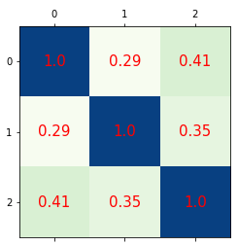
But…
+
The weather is nice decent skillful dainty overnice prissy squeamish courteous gracious
-
The weather is awful dreadful painful terrible nasty awed
?
The weather is decent clean fitting satisfactory acceptable
With Horizontal Augmentation
Original

Slide 27
Horizontal DA: Notes
+
The weather is nice decent skillful dainty overnice prissy squeamish courteous gracious
-
The weather is awful dreadful painful terrible nasty awed
?
The weather is decent clean fitting satisfactory acceptable
Possible solutions:
Only include most frequent synsets
Choose synsets randomly
Consequences:
In this case training size did not change.
  (no mess with tf-idf and model assumptions)
Increase of dimensionality
Possibility of enforcing noise
Can capture similar contexts

Slide 28
Outline
Problem Statement
  Text Classification
  Expensive training data
  Domain specific
Use cases
  News classification project at Allianz
  Legal Norm classification at Sebis chair
  Hateful speech classification of tweets
Solutions
  Semi Supervised Learning
    Self-training
    Graph based SSL
  Text Data Augmentation
    Horizontal
    Vertical
    Hypernyms
Conclusion
References

Slide 29
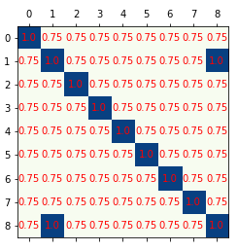
Vertical DA by Synonyms
+
The weather is nice
+
The weather is decent
Bingo!!!
+
The weather is skillful
Original
+
The weather is dainty
+
The weather is gracious
-
The weather is awful
-
The weather is dreadful
-
The weather is terrible
?
The weather is decent
Vertical DA
Binary vectorizer

Slide 30
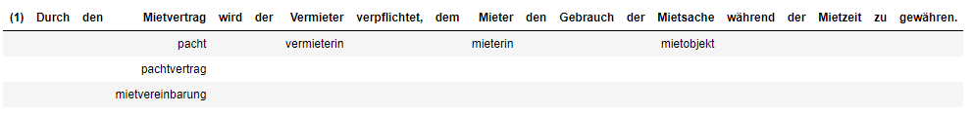
But…
In total 4*2*2*2 = 32 variation exist for only this sentence.
Computationally impossible!
Solution:
Choose random r of all possible combination.
Consequence:
There is no guarantee anymore to find a match.
Notes:
Both dimensionality and data size are increased
Augmented set should not appear in the test set (customized cross validation required)

Slide 31

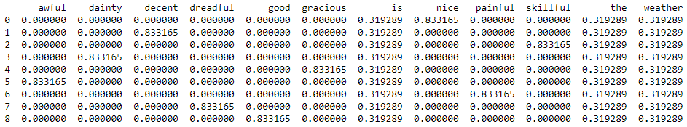
More important consequences
TF-IDF
Model Assumptions

Slide 32
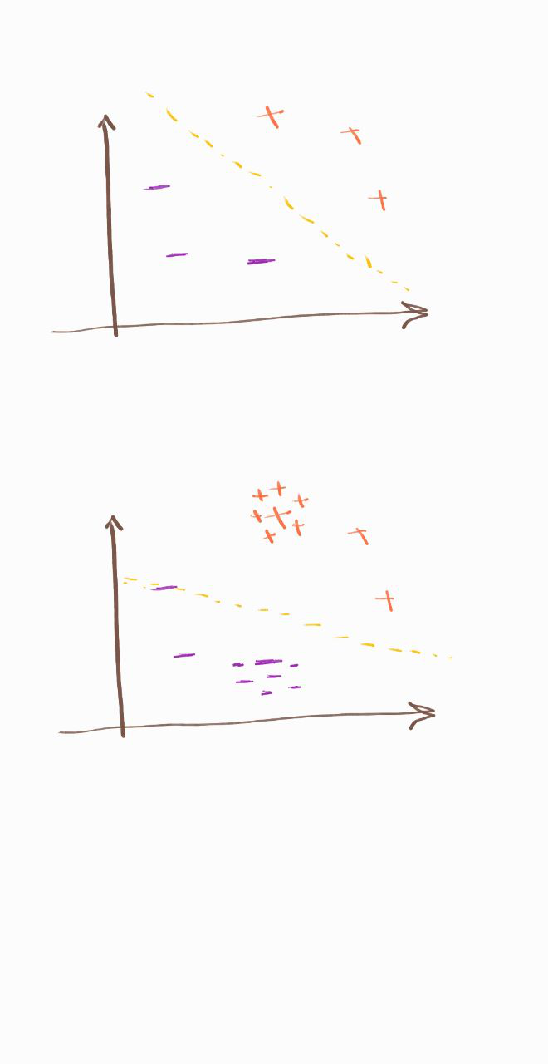
Dangerous consequences
TF-IDF
Model Assumptions

Slide 33
Dangerous consequences
TF-IDF
Model Assumptions

Slide 34
Outline
Problem Statement
  Text Classification
  Expensive training data
  Domain specific
Use cases
  News classification project at Allianz
  Legal Norm classification at Sebis chair
  Hateful speech classification of tweets
Solutions
  Semi Supervised Learning
    Self-training
    Graph based SSL
  Text Data Augmentation
    Horizontal
    Vertical
    Hypernyms
Conclusion
References

Slide 35
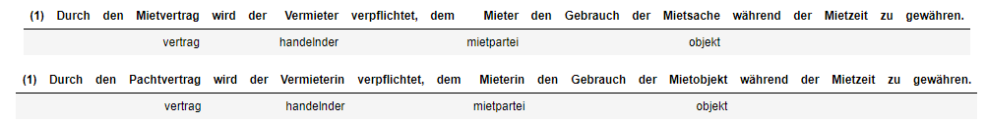
DA with Hypernyms
Dimensionality decreases
Less chance of enforcing noise
No mess with model assumptions
But:
Hypernyms set are limited
Only nouns are supported
And…(next slide)

Slide 36
But…
Semantics are more complex when it comes to informal speech(e.g. sarcasm, jokes..)
Hateful speech:
😂

Slide 37
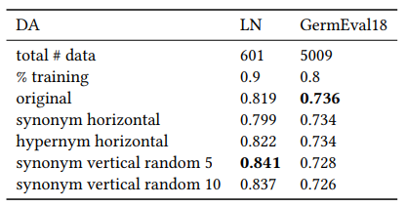
And finally, the results

Slide 38
Outline
Problem Statement
  Text Classification
  Expensive training data
  Domain specific
Use cases
  News classification project at Allianz
  Legal Norm classification at SEBIS chair
  Hateful speech classification of tweets,GermEval18
Solutions
  Semi Supervised Learning
    Self-training
    Graph based SSL
  Text Data Augmentation
    Horizontal
    Vertical
    Hypernyms
Conclusion
References

Slide 39
Conclusion
Label propagation
  The vanilla LP could not reach the best performances in all three data sets.
  We hypothesized, it is very sensitive to the parameters and noise compared to classical linear models.
Self-training
  with consideration of a threshold can increase the performance and enables the model to take advantage of a vast number of unlabeled data.
  Without a threshold has undoubtedly a negative impact.
Text data augmentation:
  Horizontal data augmentation enforces more irrelevant data which causes a negative impact on classification.
  Vertical data augmentation affects the vectorizer technique and model assumptions.
  In formal contexts, vertical DA and hypernyms are shown to be effective.
  However in informal contexts, thesaurus-based methods do not perform well due to complexity of semantics.

Slide 40
References
[1] Mehdi Allahyari, Seyedamin Pouriyeh, Mehdi Assefi, Saied Safaei, Elizabeth D Trippe, Juan B Gutierrez, and Krys Kochut. 2017. A brief survey of text mining: Classification,clustering and extraction techniques.arXiv preprint arXiv:1707.02919(2017).
[2] Daniel Cer, Yinfei Yang, Sheng-yi Kong, Nan Hua, Nicole Limtiaco, Rhomni St John, Noah Constant, Mario Guajardo-Cespedes, Steve Yuan, Chris Tar, et al.2018. Universalsentence encoder.arXiv preprint arXiv:1803.11175(2018).
[3] O. Chapelle, B. Scholkopf, and A. Zien, Eds. 2009. Semi-Supervised Learning (Chapelle, O. et al., Eds.; 2006) [Book reviews].IEEE Transactions on Neural Networks20, 3 (March2009), 542–542. https://doi.org/10.1109/TNN.2009.2015974
[4] Veronika Cheplygina, Marleen de Bruijne, and Josien PW Pluim. 2019. Not-so-supervised: a survey of semi-supervised, multi-instance, and transfer learning in medical imageanalysis.Medical Image Analysis(2019).
[5] Stephen Clark, James R Curran, and Miles Osborne. 2003. Bootstrapping POS taggers using unlabelled data. InProceedings of the seventh conference on Natural languagelearning at HLT-NAACL 2003-Volume 4. Association for Computational Linguistics, 49–55.
[6] Christiane Fellbaum. 2010. WordNet. InTheory and applications of ontology: computer applications. Springer, 231–243.
[7] Birgit Hamp and Helmut Feldweg. 1997. Germanet-a lexical-semantic net for german.Automatic information extraction and building of lexical semantic resources for NLPapplications(1997).
[8] Verena Henrich and Erhard Hinrichs. 2010. GernEdiT-the GermaNet editing tool.Proceedings of the ACL 2010 System Demonstrations(2010), 19–24.
[9] Matthew Honnibal and Ines Montani. 2017. spacy 2: Natural language understanding with bloom embeddings, convolutional neural networks and incremental parsing.Toappear(2017).[10] Jeremy Howard and Sebastian Ruder. 2018. Universal language model fine-tuning for text classification.arXiv preprint arXiv:1801.06146(2018).
[10] Rie Johnson and Tong Zhang. 2016. Supervised and semi-supervised text categorization using LSTM for region embeddings.arXiv preprint arXiv:1602.02373(2016).
[11] Anjuli Kannan, Karol Kurach, Sujith Ravi, Tobias Kaufmann, Andrew Tomkins, Balint Miklos, Greg Corrado, Laszlo Lukacs, Marina Ganea, Peter Young, et al.2016. Smartreply: Automated response suggestion for email. InProceedings of the 22nd ACM SIGKDD International Conference on Knowledge Discovery and Data Mining. ACM, 955–964.
[12] David McClosky, Eugene Charniak, and Mark Johnson. 2006. Effective self-training for parsing. InProceedings of the main conference on human language technology conferenceof the North American Chapter of the Association of Computational Linguistics. Association for Computational Linguistics, 152–159.
[13] Takeru Miyato, Andrew M Dai, and Ian Goodfellow. 2016. Adversarial training methods for semi-supervised text classification.arXiv preprint arXiv:1605.07725(2016).

Slide 41
References
[14] Miha Pavlinek and Vili Podgorelec. 2017. Text classification method based on self-training and LDA topic models.Expert Systems with Applications80 (2017), 83–93.
[15] F. Pedregosa, G. Varoquaux, A. Gramfort, V. Michel, B. Thirion, O. Grisel, M. Blondel, P. Prettenhofer, R. Weiss, V. Dubourg, J. Vanderplas, A. Passos, D. Cournapeau, M. Brucher,M. Perrot, and E. Duchesnay. 2011. Scikit-learn: Machine Learning in Python.Journal of Machine Learning Research12 (2011), 2825–2830.
[16] Luis Perez and Jason Wang. 2017. The effectiveness of data augmentation in image classification using deep learning.arXiv preprint arXiv:1712.04621(2017).
[17] Shrutika S Sawant and Manoharan Prabukumar. 2018. A review on graph-based semi-supervised learning methods for hyperspectral image classification.The Egyptian Journalof Remote Sensing and Space Science(2018).
[18] Xiao Sun and Jiajin He. 2018. A novel approach to generate a large scale of supervised data for short text sentiment analysis.Multimedia Tools and Applications(2018), 1–21.
[19] Bernhard Waltl, Georg Bonczek, Elena Scepankova, and Florian Matthes. 2019. Semantic types of legal norms in German laws: classification and analysis using local linearexplanations.Artificial Intelligence and Law27, 1 (2019), 43–71.
[20] Bernhard Waltl, Johannes Muhr, Ingo Glaser, Georg Bonczek, Elena Scepankova, and Florian Matthes. 2017. Classifying Legal Norms with Active Machine Learning.. InJURIX.11–20.
[21] Michael Wiegand, Melanie Siegel, and Josef Ruppenhofer. 2018. Overview of the GermEval 2018 Shared Task on the Identification of Offensive Language. In14th Conference onNatural Language Processing KONVENS 2018.
[22] Yibing Yang and M Omair Shafiq. 2018. Large scale and parallel sentiment analysis based on Label Propagation in Twitter Data. In2018 17th IEEE International Conference OnTrust, Security And Privacy In Computing And Communications/12th IEEE International Conference On Big Data Science And Engineering (TrustCom/BigDataSE). IEEE, 1791–1798.
[23] Xiang Zhang and Yann LeCun. 2015. Text understanding from scratch.arXiv preprint arXiv:1502.01710(2015).
[24] Dengyong Zhou, Olivier Bousquet, Thomas N Lal, Jason Weston, and Bernhard Schölkopf. 2004. Learning with local and global consistency. InAdvances in neural informationprocessing systems. 321–328.
[25] Xiaojin Zhu, Zoubin Ghahramani, and John D Lafferty. 2003. Semi-supervised learning using gaussian fields and harmonic functions. InProceedings of the 20th Internationalconference on Machine learning (ICML-03). 912–919.
[26] Xiaojin Zhu and Andrew B Goldberg. 2009. Introduction to semi-supervised learning.Synthesis lectures on artificial intelligence and machine learning3, 1 (2009), 1–130.
[27] Xiaojin Jerry Zhu. 2005.Semi-supervised learning literature survey. Technical Report. University of Wisconsin-Madison Department of Computer Sciences.

Slide 42
Thank You
Question?

